Slide 1
CPSC 483 Dimensionality Reduction
Anand Panangadan
apanangadan@fullerton.edu

Slide 2
What we will cover this week
Need for dimensionality reduction
Linear methods
Nonlinear methods

Slide 3
Curse of dimensionality
When dimensionality increases, data becomes increasingly sparse
Distance between points becomes less meaningful
Most points in a high-dimensional hypercube are very close to the edges; the interior is “empty”
ML relies on identifying similar data points in the training set
But in high dimensional spaces, distance between any two points is the almost the same
The possible combinations of subspaces grows exponentially

Slide 4
Dimensionality reduction
Avoid the curse of dimensionality
Help eliminate irrelevant features and reduce noise
Reduce time and space costs in data mining
Allow easier visualization

Slide 5
Dimensionality reduction techniques
Projection
Principal Component Analysis (PCA)
Singular Vector Decomposition (SVD)
Manifold learning

Slide 6
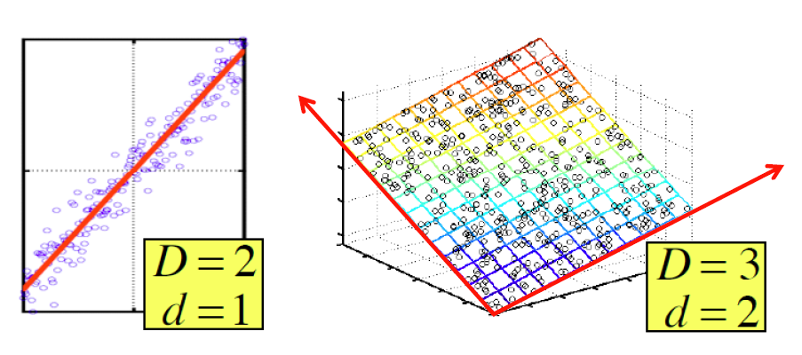
Manifold assumption
In real-world datasets,
points lie on or near a low d-dimensional subspace
Axes of this subspace are effective representation of the data

Slide 7

Rank of A Matrix
What is rank of a matrix A?
Number of linearly independent columns of A
Example
Matrix A =
Rank r = 2
What do we care about low rank?
New coordinates to represent the original data
We can write A as two “basis” vectors: [1 2 1] [-2 -3 1]
Notes:
The first two rows are linearly independent, so the rank is at least 2, but all three rows are linearly dependent (the first is equal to the sum of the second and third) so the rank must be less than 3.

Slide 8
Rank is Dimensionality
Cloud of points 3D space:
Think of point positions as a matrix:
We can rewrite coordinates more efficiently!
Old basis vectors: [1 0 0] [0 1 0] [0 0 1]
New basis vectors: [1 2 1] [-2 -3 1]
Then A has new coordinates: [1 0]. B: [0 1], C: [1 1]
Notice: We reduced the number of coordinates
A
B
C
A
One row per point:

Slide 9
Principle Component Analysis
Goal: To find a projection of data that captures the largest amount of variation in data
The original data are projected onto a much smaller space, resulting in dimensionality reduction
The direction with the largest projected variance is called the first principal component
The orthogonal direction that captures the second largest projected variance is called the second principal component
and so on…
The direction that maximizes the variance is also the one that minimizes the mean squared error

Slide 10
Example
A dataset resulting from a survey of pilots for radio-controlled helicopters
x₁ is a measure of the piloting skill of a pilot
x₂ captures how much he/she enjoys flying
The two attributes x₁ and x₂ are strongly correlated!
The data actually lie along
some diagonal axis (u₁)
Question: how can we
automatically compute u₁ ?

Slide 11
Problem Formulation
Reduce data from d-dimension to k-dimension (k << d)
Find k vectors u₁, u₂, …,u_{k} onto which to project data so as to
maximize the variance of the projected data
minimize the projection error (squared projection distance)

Slide 12
PCA: General Procedure
Given n data vectors from d-dimensions, find k ≤ d orthogonal vectors (principal components) that can represent data
Normalize input data: Each attribute falls within the same range
Compute k orthonormal (unit) vectors, i.e., principal components
Each input data (vector) is a linear combination of the k principal component vectors
The principal components are sorted in order of decreasing “significance” or strength
Since the components are sorted, the size of the data can be reduced by eliminating the weak components, i.e., those with low variance (using the strongest k principal components, it is possible to reconstruct a good approximation of the original data)

Slide 13
PCA: Input
Input: an n*d data matrix D
Rows: also called instances, examples, records, transactions, objects, points, feature-vectors, etc. Given as a d-tuple
x_{i} = (x_{i1}, x_{i2}, . . . , x_{id})
Columns: also called attributes, properties, features, dimensions, variables, fields, etc. Given as an n-tuple
x_{j} = (x_{1j}, x_{2j}, . . . , x_{nj})

Slide 14
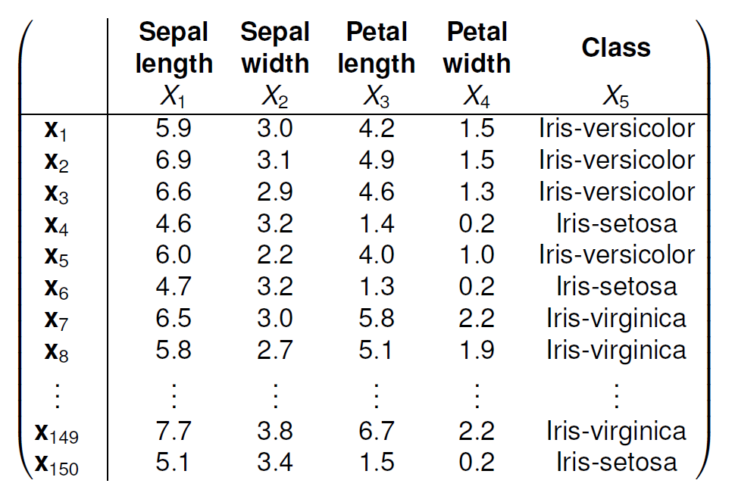
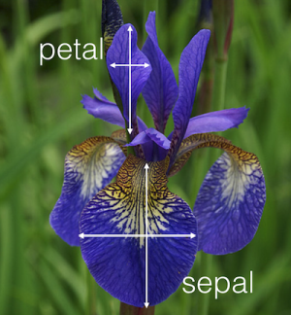
An Example

Slide 15
PCA: Algorithm
Preprocessing the data to normalize its mean and variance
The mean of the data matrix D is the average of all the points
Replace each x_{i} with x_{i} – μ to get the centered data matrix Z
Steps 1-2 zero out the mean of the data

Slide 16
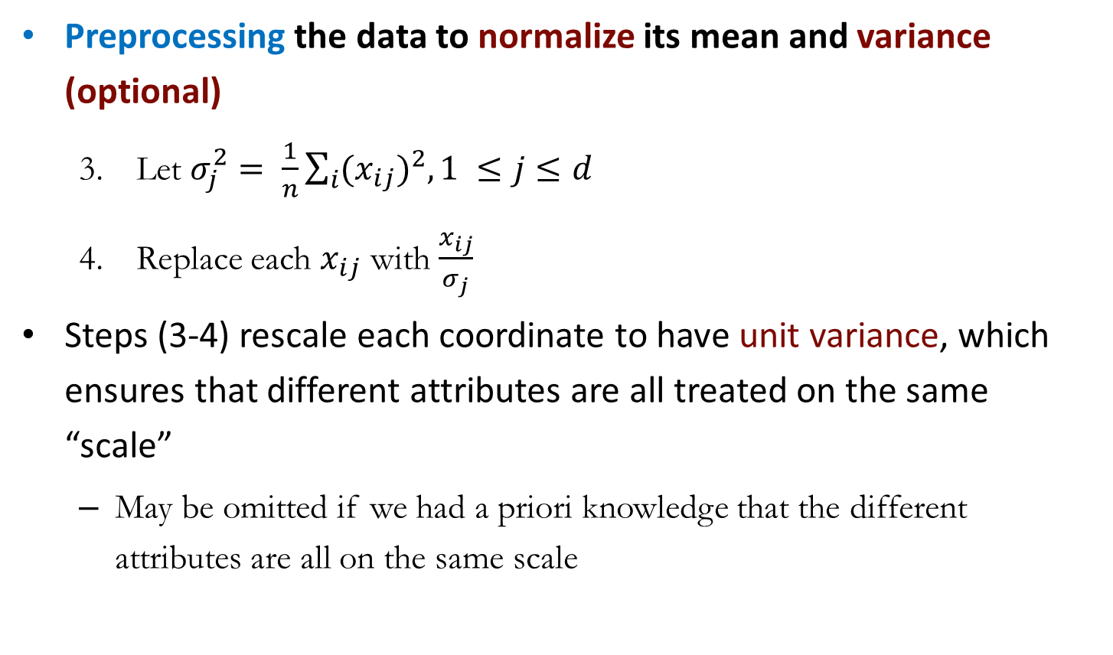
PCA: Algorithm
Preprocessing the data to normalize its mean and variance (optional)
Let $σ_{j}^{2}= \frac{1}{n}\sum_{i}{{{(x}_{ij})}^{2}, 1 ≤j≤d}$
Replace each $x_{ij}$ with $\frac{x_{ij}}{σ_{j}}$
Steps (3-4) rescale each coordinate to have unit variance, which ensures that different attributes are all treated on the same “scale”
May be omitted if we had a priori knowledge that the different attributes are all on the same scale

Slide 17
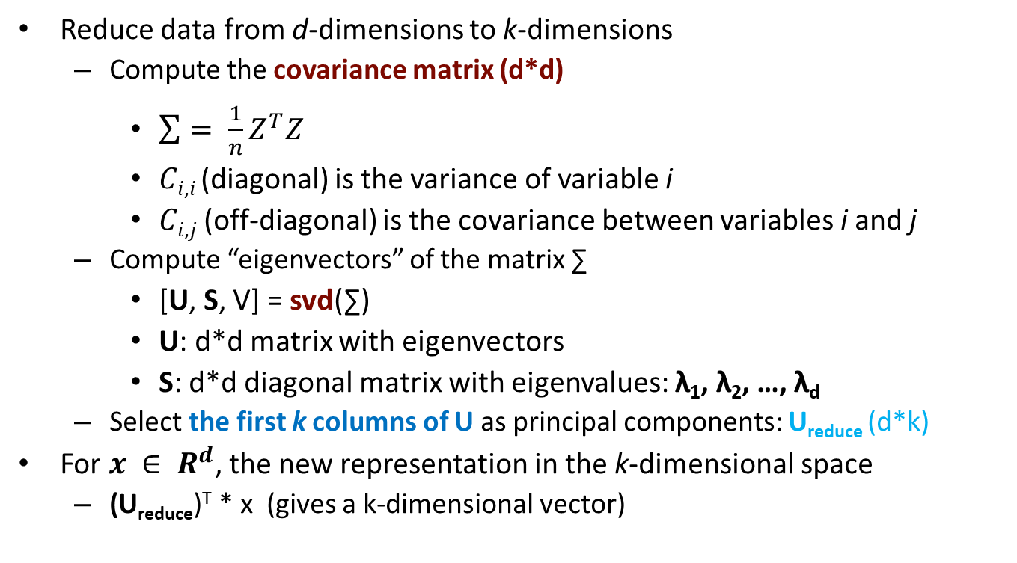
PCA: Algorithm
Reduce data from d-dimensions to k-dimensions
Compute the covariance matrix (d*d)
$\sum{= \frac{1}{n}Z^{T}Z}$
𝐶_{𝑖,𝑖} (diagonal) is the variance of variable i
𝐶_{𝑖,𝑗} (off-diagonal) is the covariance between variables i and j
Compute “eigenvectors” of the matrix ∑
[U, S, V] = svd(∑)
U: d*d matrix with eigenvectors
S: d*d diagonal matrix with eigenvalues: λ₁, λ₂, …, λ_{d}
Select the first k columns of U as principal components: U_{reduce} (d*k)
For $x ∈ R^{d}$, the new representation in the k-dimensional space
(U_{reduce})^{T} * x (gives a k-dimensional vector)

Slide 18
How to set the number of dimensions
One criteria for choosing k is to compute the fraction of the total variance captured by the first k principal components
Given a certain desired variance threshold, say α, starting from the first principal component, we keep on adding additional components, and stop at the smallest value k, for which f (k) ≥ α
we select the fewest number of dimensions such that the subspace spanned by those k dimensions captures at least α fraction of the total variance

Slide 19
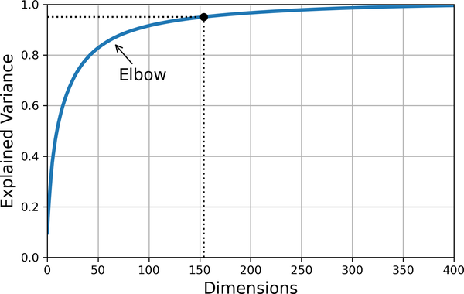
Explained variance vs dimensions

Slide 20
PCA: Algorithm

Slide 21
PCA: Example

Slide 22
Optimal and Non-optimal 2D Approximations
The optimal subspace maximizes the variance, and minimizes the squared error,
Non-optimal subspaces capture less variance, and have higher mean squared error

Slide 23
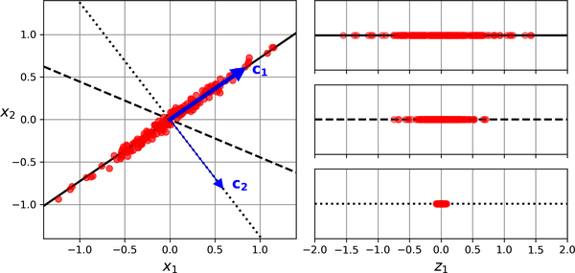
Optimal and Non-optimal 2D Approximations
The optimal subspace maximizes the variance, and minimizes the squared error,
Non-optimal subspaces capture less variance, and have higher mean squared error

Slide 24
Singular Vector Decomposition
A_{[m x n]} = U_{[m x r]} Σ _{[ r x r]} (V_{[n x r]})^{T}
A: Input data matrix
m x n matrix (e.g., m documents, n terms)
U: Left singular vectors
m x r matrix (m documents, r concepts)
Σ: Singular values
r x r diagonal matrix (strength of each ‘concept’) (r : rank of the matrix A)
V: Right singular vectors
n x r matrix (n terms, r concepts)

Slide 25
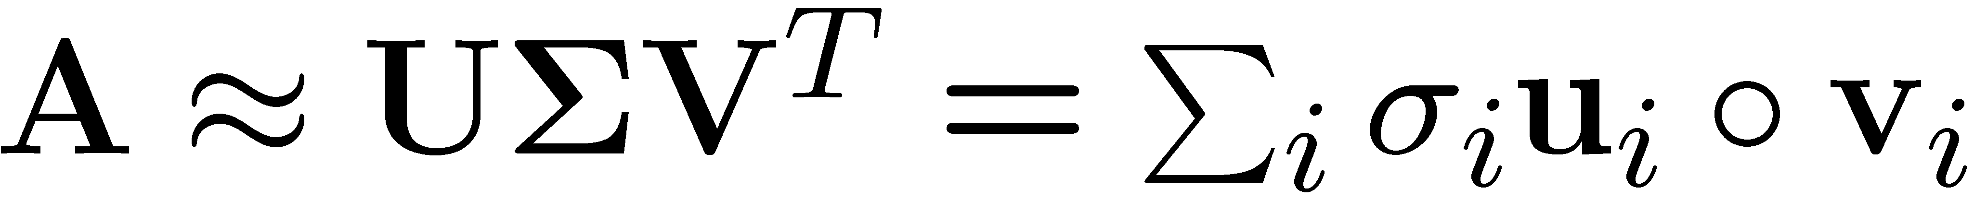
SVD
T
n
r
r
n
r
A
≈
Σ
V^{T}
m
m
U
σ_{i}: singular values
u_{i}: orthonormal vector
v_{i}: orthonormal vector

Slide 26
SVD - Properties
It is always possible to decompose a real matrix A into A = U Σ V^{T} , where
U, Σ,V: unique
U, V: column orthonormal
U^{T} U = I; V^{T} V = I (I: identity matrix)
(Columns are orthogonal unit vectors)
Σ: diagonal
Entries (singular values) are positive, and sorted in decreasing order (σ₁ ≥ σ₂ ≥ ... ≥ 0)

Slide 27
SVD: Example
Matrix
Alien
Star Wars
Casablanca
Titanic
A = U Σ V^{T}: Users to Movies
n
Alex
Bob
Chris
Dave
Eason
Frank
Gil
1 1 1 0 0
3 3 3 0 0
4 4 4 0 0
5 5 5 0 0
0 2 0 4 4
0 0 0 5 5
0 1 0 2 2
Σ
V^{T}
=
m
U
“Concepts” a.k.a. Latent dimensions

Slide 28
SVD: Example
Matrix
Alien
Star Wars
Casablanca
Titanic
A = U Σ V^{T}: Users to Movies
Alex
Bob
Chris
Dave
Eason
Frank
Gil
1 1 1 0 0
3 3 3 0 0
4 4 4 0 0
5 5 5 0 0
0 2 0 4 4
0 0 0 5 5
0 1 0 2 2
0.13 0.02 -0.01
0.41 0.07 -0.03
0.55 0.09 -0.04
0.68 0.11 -0.05
0.15 -0.59 0.65
0.07 -0.73 -0.67
0.07 -0.29 0.32
12.4 0 0
0 9.5 0
0 0 1.3
=
x
x
0.56 0.59 0.56 0.09 0.09
0.12 -0.02 0.12 -0.69 -0.69
0.40 -0.80 0.40 0.09 0.09

Slide 29
SVD: Example
Matrix
Alien
Star Wars
Casablanca
Titanic
A = U Σ V^{T}: Users to Movies
U is the “user-to-concept”
similarity matrix
Sci. Fiction
Romance
Alex
Bob
Chris
Dave
Eason
Frank
Gil
1 1 1 0 0
3 3 3 0 0
4 4 4 0 0
5 5 5 0 0
0 2 0 4 4
0 0 0 5 5
0 1 0 2 2
0.13 0.02 -0.01
0.41 0.07 -0.03
0.55 0.09 -0.04
0.68 0.11 -0.05
0.15 -0.59 0.65
0.07 -0.73 -0.67
0.07 -0.29 0.32
12.4 0 0
0 9.5 0
0 0 1.3
=
x
x
0.56 0.59 0.56 0.09 0.09
0.12 -0.02 0.12 -0.69 -0.69
0.40 -0.80 0.40 0.09 0.09

Slide 30
SVD: Example
Matrix
Alien
Star Wars
Casablanca
Titanic
A = U Σ V^{T}: Users to Movies
“Strength” of the concept for Sci. Fiction
Sci. Fiction
Alex
Bob
Chris
Dave
Eason
Frank
Gil
1 1 1 0 0
3 3 3 0 0
4 4 4 0 0
5 5 5 0 0
0 2 0 4 4
0 0 0 5 5
0 1 0 2 2
0.13 0.02 -0.01
0.41 0.07 -0.03
0.55 0.09 -0.04
0.68 0.11 -0.05
0.15 -0.59 0.65
0.07 -0.73 -0.67
0.07 -0.29 0.32
12.4 0 0
0 9.5 0
0 0 1.3
=
x
x
0.56 0.59 0.56 0.09 0.09
0.12 -0.02 0.12 -0.69 -0.69
0.40 -0.80 0.40 0.09 0.09

Slide 31
SVD: Example
Matrix
Alien
Star Wars
Casablanca
Titanic
A = U Σ V^{T}: Users to Movies
V is the “movie-to-concept”
similarity matrix
Sci. Fiction
Alex
Bob
Chris
Dave
Eason
Frank
Gil
1 1 1 0 0
3 3 3 0 0
4 4 4 0 0
5 5 5 0 0
0 2 0 4 4
0 0 0 5 5
0 1 0 2 2
0.13 0.02 -0.01
0.41 0.07 -0.03
0.55 0.09 -0.04
0.68 0.11 -0.05
0.15 -0.59 0.65
0.07 -0.73 -0.67
0.07 -0.29 0.32
12.4 0 0
0 9.5 0
0 0 1.3
=
x
x
Sci. Fiction
0.56 0.59 0.56 0.09 0.09
0.12 -0.02 0.12 -0.69 -0.69
0.40 -0.80 0.40 0.09 0.09

Slide 32
SVD: Example
Dimensionality reduction based on SVD
Set the smallest singular values to ZERO
1 1 1 0 0
3 3 3 0 0
4 4 4 0 0
5 5 5 0 0
0 2 0 4 4
0 0 0 5 5
0 1 0 2 2
0.13 0.02 -0.01
0.41 0.07 -0.03
0.55 0.09 -0.04
0.68 0.11 -0.05
0.15 -0.59 0.65
0.07 -0.73 -0.67
0.07 -0.29 0.32
12.4 0 0
0 9.5 0
0 0 1.3
≈
=
x
x
0.56 0.59 0.56 0.09 0.09
0.12 -0.02 0.12 -0.69 -0.69
0.40 -0.80 0.40 0.09 0.09

Slide 33
SVD: Example
Dimensionality reduction based on SVD
Set the smallest singular values to ZERO
1 1 1 0 0
3 3 3 0 0
4 4 4 0 0
5 5 5 0 0
0 2 0 4 4
0 0 0 5 5
0 1 0 2 2
0.13 0.02
0.41 0.07
0.55 0.09
0.68 0.11
0.15 -0.59
0.07 -0.73
0.07 -0.29
12.4 0
0 9.5
≈
x
x
0.56 0.59 0.56 0.09 0.09
0.12 -0.02 0.12 -0.69 -0.69

Slide 34
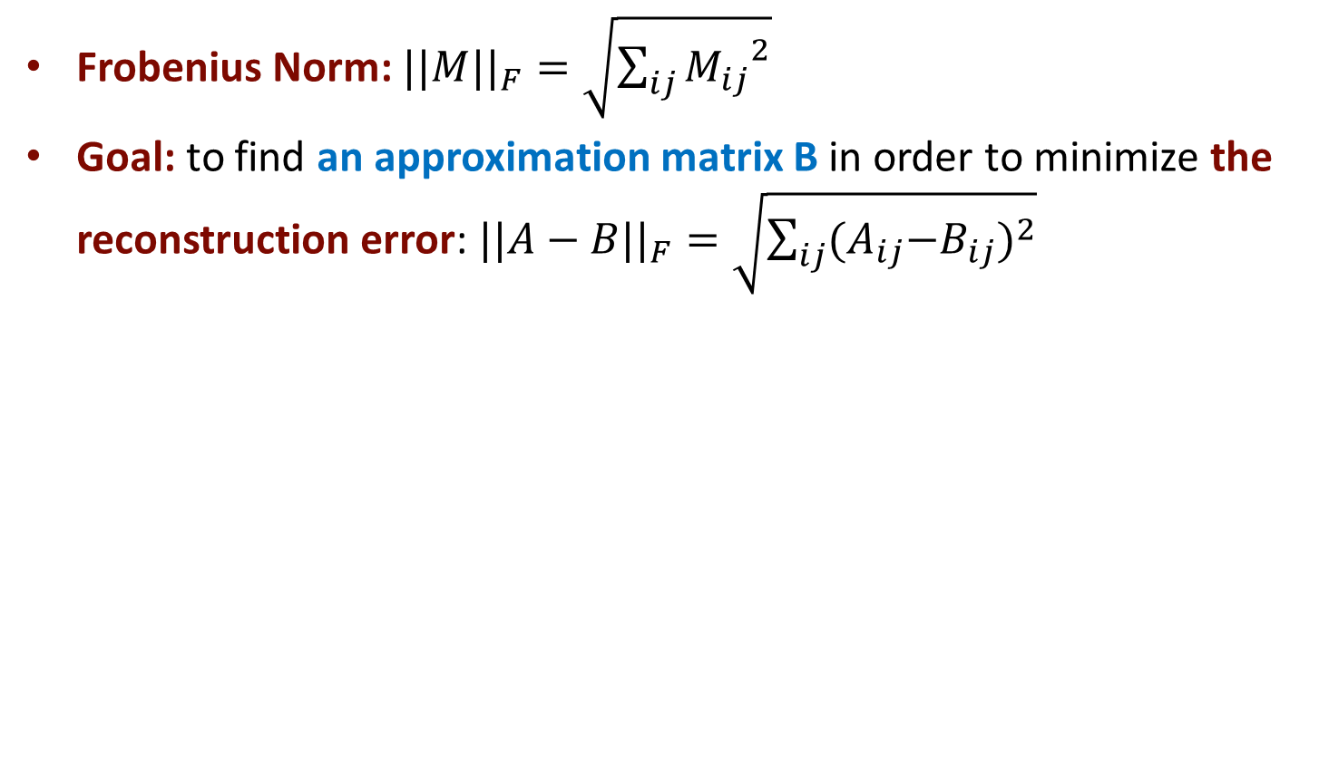
SVD: Best Low-rank Approximation
Frobenius Norm: ${||M||}_{F}=\sqrt{\sum_{ij}{{M_{ij}}^{2}}}$
Goal: to find an approximation matrix B in order to minimize the reconstruction error: ${||A−B||}_{F}=\sqrt{\sum_{ij}{{{(A}_{ij}−B_{ij})}^{2}}}$
1 1 1 0 0
3 3 3 0 0
4 4 4 0 0
5 5 5 0 0
0 2 0 4 4
0 0 0 5 5
0 1 0 2 2
0.92 0.95 0.92 0.01 0.01
2.91 3.01 2.91 -0.01 -0.01
3.90 4.04 3.90 0.01 0.01
4.82 5.00 4.82 0.03 0.03
0.70 0.53 0.70 4.11 4.11
-0.69 1.34 -0.69 4.78 4.78
0.32 0.23 0.32 2.01 2.01
≈

Slide 35
SVD: Best Low-rank Approximation
A
U
Sigma
=
V^{T}
B is best approximation of A
B
U
Sigma
=
V^{T}

Slide 36
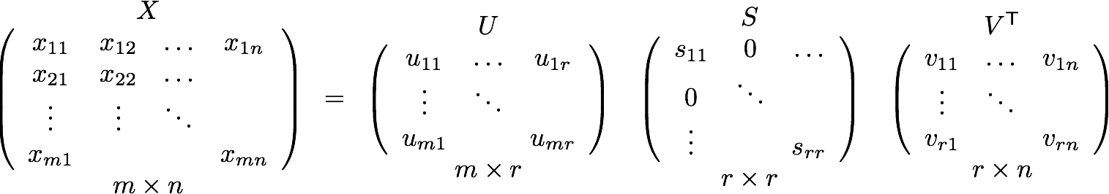
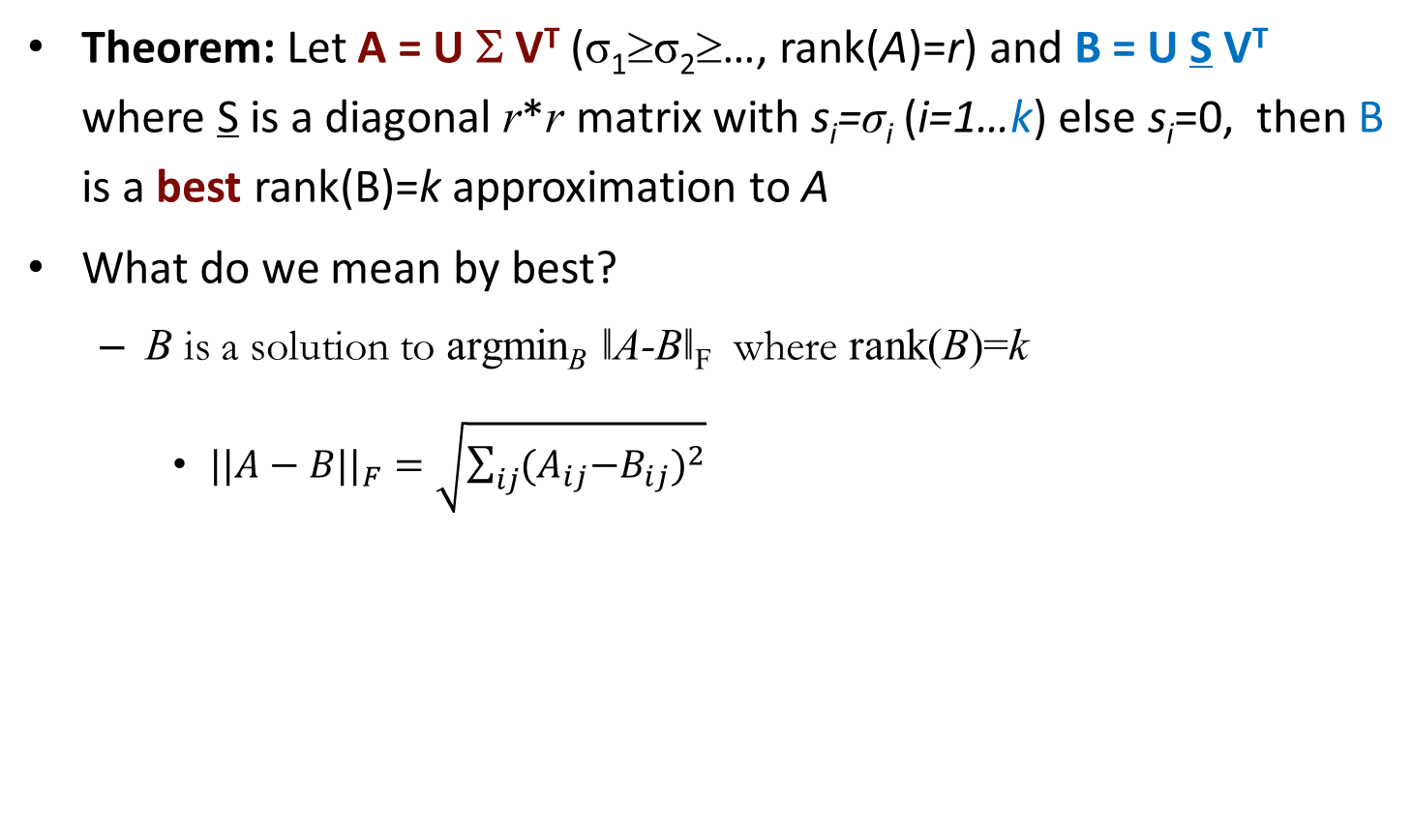
SVD: Best Low-rank Approximation
Theorem: Let A = U Σ V^{T} (σ₁≥σ₂≥…, rank(A)=r) and B = U S V^{T} where S is a diagonal r*r matrix with s_{i}=σ_{i} (i=1…k) else s_{i}=0, then B is a best rank(B)=k approximation to A
What do we mean by best?
B is a solution to argmin_{B} ǁA-Bǁ_{F} where rank(B)=k
${||A−B||}_{F}=\sqrt{\sum_{ij}{{{(A}_{ij}−B_{ij})}^{2}}}$

Slide 37
SVD vs. PCA
Σ is a diagonal matrix containing the square roots of eigenvalues from U or V in descending order

Slide 38
SVD: Summary
SVD: A= U Σ V^{T}: unique
U: user-to-concept similarities
V: movie-to-concept similarities
Σ : strength of each concept
Complexity
Min{O(nm²), O(n²m)}
In practice it needs much less work, if we only want singular values, or the first k singular vectors, or the matrix is sparse
Optimal low-rank approximation of A in terms of Frobenius norm

Slide 39
PCA in scikit-learn
from sklearn.decomposition import PCA
pca = PCA(n_components=2)
X2D = pca.fit_transform(X)
# Note: components = dimensions

Slide 40
Class work
Reduce the 4-dimensional iris dataset to 2 dimensions
Plot Sepal.Length vs Sepal.Width
Color points using Species
Plot Petal.Length vs Petal.Width
Color points using Species
Use PCA() to get a 2-dimensional approximation
Plot the 2-dimensional dataset
Color points using Species
Which of the plots appear easiest to classify into Species?

Slide 41
Textbook code
Textbook code
Textbook code on Google Colab
Open 08_dimensionality_reduction.ipynb

Slide 42
Manifold Learning

Slide 43
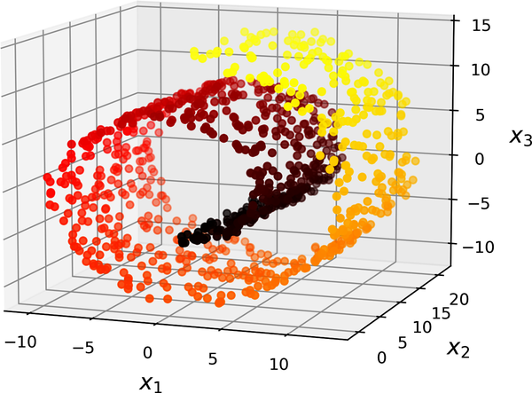
“Swiss roll” dataset

Slide 44
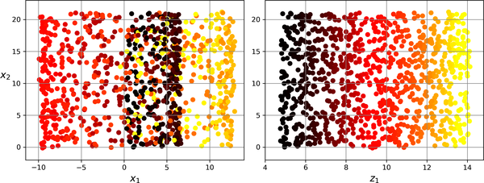
Projection vs Manifold learning of the Swiss roll dataset

Slide 45
Locally linear embedding (LLE)
Locally linear embedding (LLE)⁠ is a nonlinear dimensionality reduction (NLDR) technique.
Does not rely on projections
Two step approach
LLE computes how each training instance linearly relates to its nearest neighbors
Optimize for a low-dimensional representation of the training set where these local relationships are best preserved

Slide 46
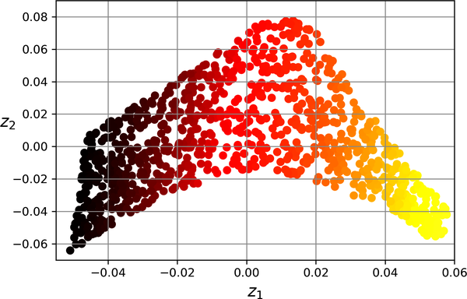
Locally linear embedding (LLE)

Slide 47
LLE in scikit-learn
from sklearn.datasets import make_swiss_roll
from sklearn.manifold import LocallyLinearEmbedding
X_swiss, t = make_swiss_roll(n_samples=1000, noise=0.2)
lle = LocallyLinearEmbedding(n_components=2, n_neighbors=10)
X_unrolled = lle.fit_transform(X_swiss)

Slide 48
Class work
Reduce the 4-dimensional iris dataset to 2 dimensions using LLE
Use LocallyLinearEmbedding() to get a 2-dimensional approximation
Plot the 2-dimensional dataset
Color points using Species
Does this plot appear easier to classify into Species compared to the PCA plots?

Slide 49
Other approaches
Multidimensional scaling (MDS)
Isomap
t-distributed stochastic neighbor embedding (t-SNE)

Slide 50
Acknowledgement
Content based on “Hands-On Machine Learning with Scikit-Learn, Keras, and TensorFlow,” Aurélien Géron, 3rd Edition (October 2022), O'Reilly Media, Inc.
Dimensionality Reduction by Peixiang Zhao

